Slide 1
overview of A.I & M.L
Speaker: Janak
Bangalore
5-06-2023

Slide 2
Outline & Content
What is Artificial intelligence?
What is Machine learning?
Types of learning (SL,USL,RL)
Difference between M.L and D.L
OOPS Concepts
Features, Labels and Models
Machine learning Algorithms
Regression and Classification

Slide 3

What is Artificial intelligence(A.I)?
Artificial Intelligence (A.I) is some times called machine intelligence (or) in simple words , human intelligence built in machines(computers).

Slide 4

What is Machine learning(M.L)?
It is a branch of artificial intelligence which helps the machines to learn . It is necessary and important for computers to acquire sufficient knowledge .

Slide 5
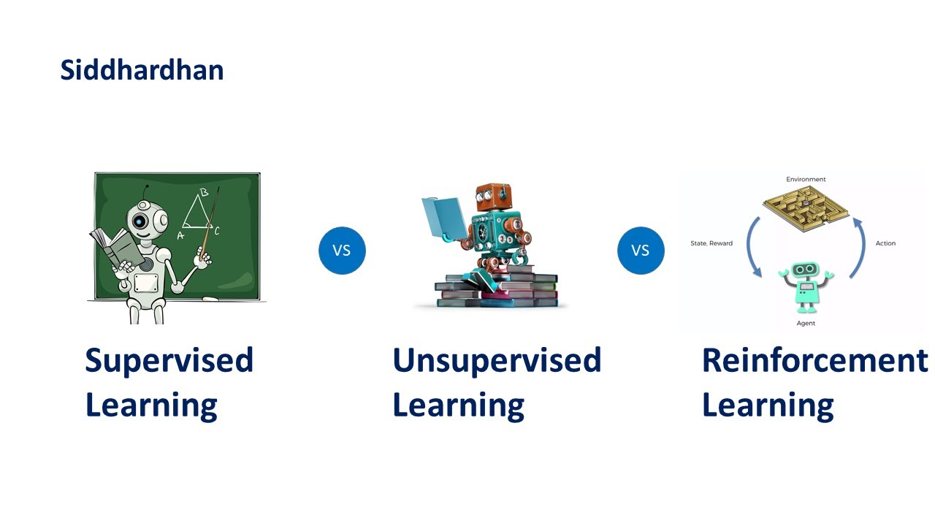
Types of machine learning

Slide 6
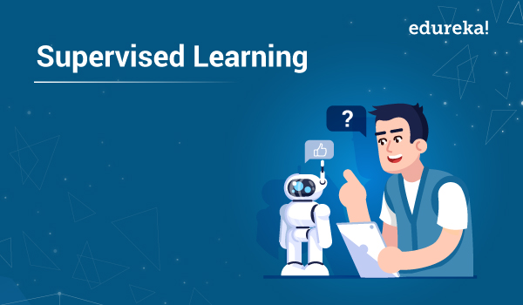
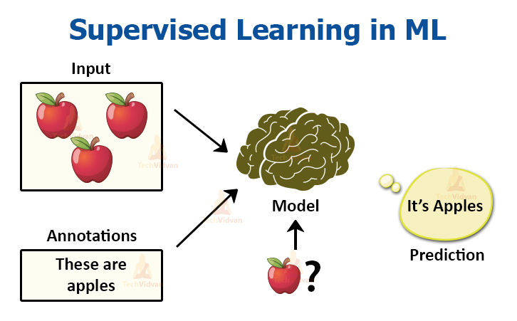
Supervised learning
Learning from others , under some guidance
Features and Labels
Two types of algorithms : Regression & classification

Slide 7
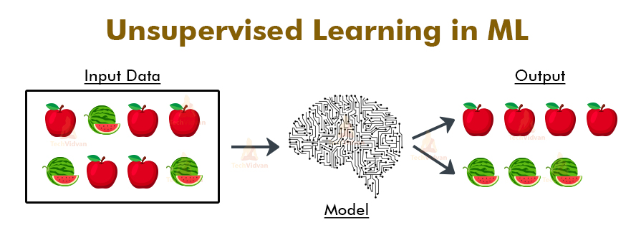
Unsupervised learning
Learning on our own without taking the help of others by books , online etc.
Only features
Clustering and association

Slide 8
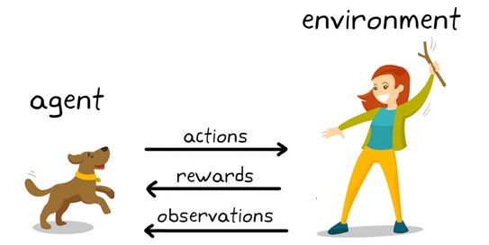
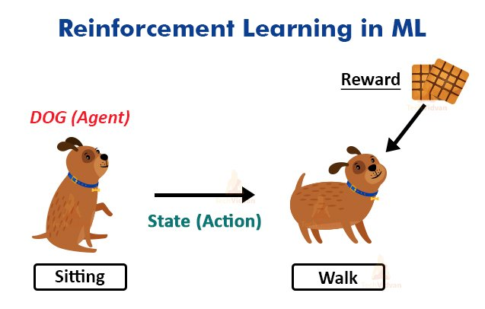
Reinforcement learning
Learning by the process of rewards and penalty.
The agent is rewarded for every correct point and penalized (penalty) for every wrong answer.

Slide 9
Difference b/w M.L & D.L
Machine learning:- We give input and output to the machine learning algorithm it builds a model.
INPUT BUILDS
OUTPUT MODEL
Deep learning:- We give input and output to the neural networks it builds a model.
INPUT BUILDS
OUTPUT MODEL
MACHINE LEARNING ALGORITM
ARTIFICIAL NEURAL NETWORKS

Slide 10
OOPS CONCEPTS
CLASS:- Class is a definition ( the program stored in secondary memory.
OBJET:- Object is the instance of a class(the program transferred to main memory to work).
INHERITANCE:- It is capability of a class to inherit the properties from parent class.
MULTIPLE INHERITANCE:- Deriving a class from more than two classes.
POLYMORPHISM:- Describes behaving differently in different situations.
ENCAPSULATION:- Putting data members and methods together in a class.
OVERLOADING:- Using same operators for many works.
OVERRIDING:- Rewriting the code which came from the parent.

Slide 11
FEATURES, LABELS & MODELS
F(x) = 3x+5(Function)
X=2 F(x)=11 ……… Input 2 and output 11
X=3 F(x)=14 ……... Input 3 and output 14
X=4 F(x)=17 ……… Input 4 and output 17
X=5 F(x)=20 ……... Input 5 and output 20
What is x=7?
Inputs are called features
Outputs are called labels
Function is called model. Here the function is 3x+5 (the given equation)

Slide 12
Machine learning-Algorithms
Linear Regression:- It is a method used to predict the dependent variable(y) based on the independent variable(x) .
Logistic regression:- It is a method used to predict a dependent variable , given a set of independent variable.
Decision tree:- In this algorithm the final decision is made by a single person (or) one person.
Random forest:-Random forest is constructed using multiple decision trees and the final decision is obtained by majority votes .
K nearest neighbor (KNN):- The nearest neighbor based on similar characteristics.
Support vector mission (SVM):- selected (or) grouped on the basis of similar features.
Naive Bayes algorithm:- it is an algorithm used for solving classification machine learning problems.

Slide 13
Regression & Classification
Regression:- The data which is continuous is called Regression.
Example:
PENS 1 2 3 4
RUPEES 1 2 3 4
Classification:- The data which is discrete (or) non-continuous is called Classification.
Example: Today (or) Tomorrow
True (or) False
Pass (or) Fail ……..Etc.

